Slide 1
Interaksi Manusia dan Komputer (IMK)
THE USER INTERFACE (UI) DESIGN PROCESS
Step 13 Organize and Layout Windows and Pages
Step 14
Testing

Slide 2
Interaksi Manusia dan Komputer (IMK)
THE USER INTERFACE (UI) DESIGN PROCESS
Step 13 Organize and Layout Windows and Pages

Slide 3
Tujuan
Setelah mengikuti materi ini mahasiswa dapat:
Mahasiswa/i dapat mampu menerapkan pengaturan dan tataletak Windows dan halaman web yang sesuai dan bermakna.

Slide 4
Objectives of Windows/Pages Layout and Organization

Slide 5
Opening
Mempercepat Pemahaman Informasi
Pengaturan/ Pengorganisasian Layout windows dan halaman web yang baik
Mempercepat Proses Eksekusi Task dan fungsi
Meningkatkan User Acceptance

Slide 6
Our Goal
Organizing and laying out graphical and web screens to encourage quick and accurate information comprehension and control execution
Organizing Meaningfully and efficiently
Creating Grouping
Providing Allignment and balance

Slide 7
Guidelines for Deciding Pages Layout

Slide 8
General Guidelines (Review step 3)
Amount of information
To much is confusing, to little is inefficient
Proportion of information to more than 30-40% of the window entire area
Flow
Provide ordering that logical, sequencial, and rhythmic
Maintain a top down, left to right flow
Navigation
Efificiency, minimize cursor and pointer travel, minimize hands travel of user from mouse to keyboard
Visually pleasing composition
Leave sufficient margin around all screen elements and between elements and the screen border
Count the tabs, count the “click”
Consistency
Balance, grouping and alignment
Adequate use of white space
Proper Emphasis of element
Provide consistency with user experiences and cultural convention
Provide consistency on operational and navigational procedure
Consistency on presentation
Critical, important, secondary, peripheral

Slide 9
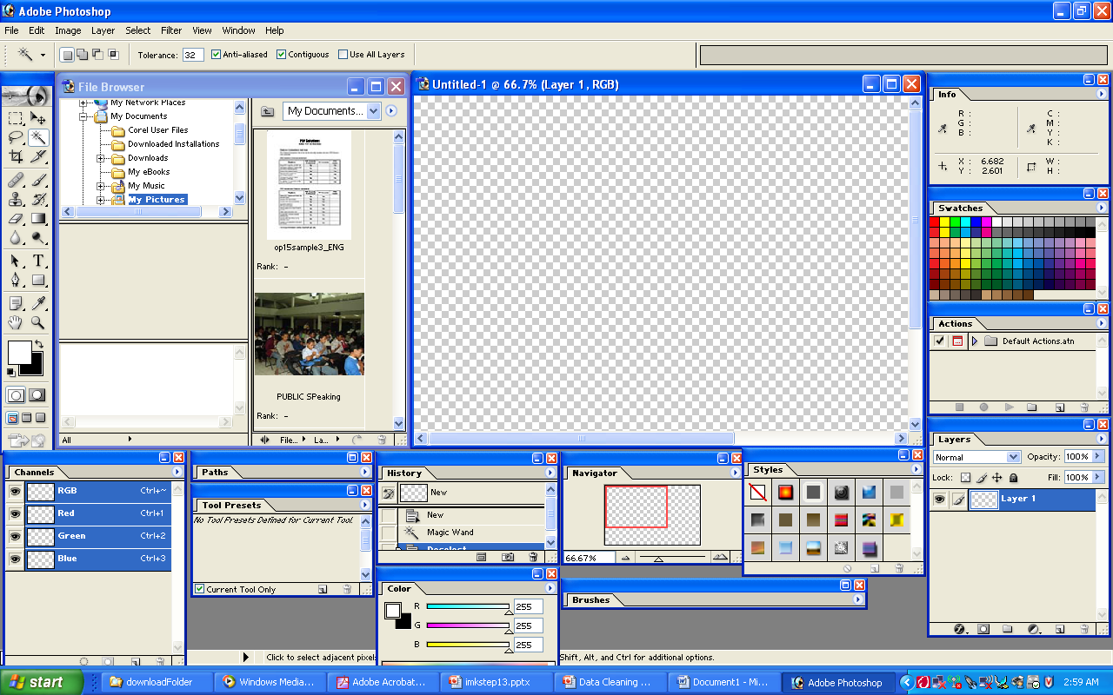
Bagaimana menurut anda ketika tampilan awal photoshop adalah seperti ini??
Notes:
Too many, confusing
Smua fitur ditampilkan ➔ seharusnya yang ditampilkan adalah yang dibutuhkan saja
Letak fungsi tidak dikelompokkan sesuai domainnya….
Area kerja jadi terbatas….

Slide 10
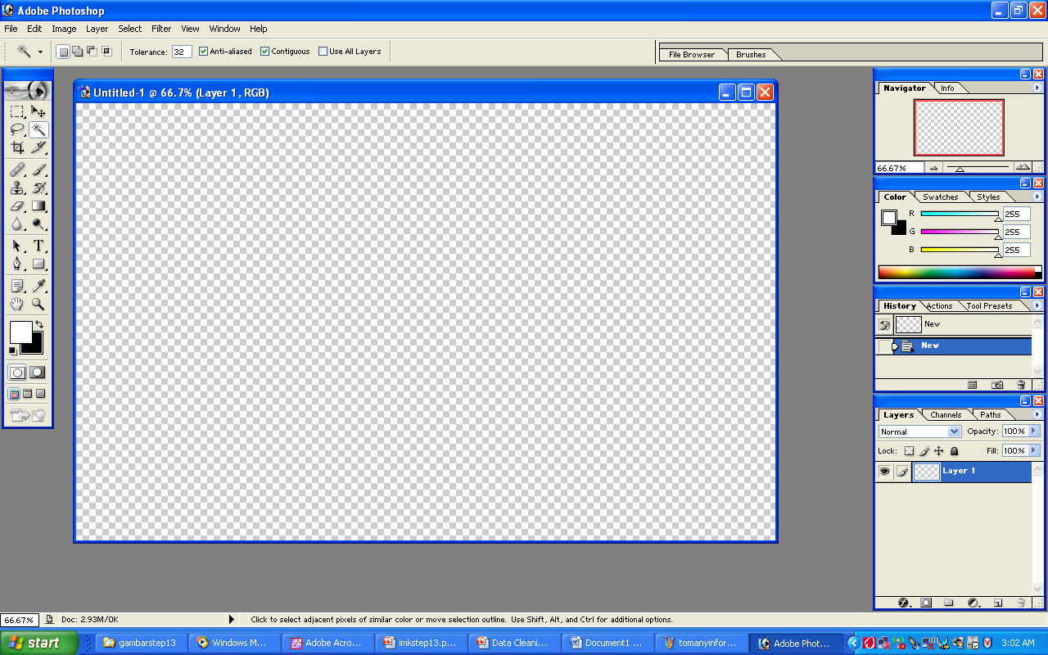
Bagaimana menurut anda ketika tampilan awal photoshop adalah seperti ini?? BANDINGKAN!!

Slide 11
Organization Guideline (Creating Grouping)
General
Provide grouping of associated elements
White Space
Headings
Provide section heading and subsection heading for multiple control grouping
Provide adequate separation of grouping through the use of white space
Leave adequate space around groups or related control, between grouping and windows border
The space between grouping should be greater than the space between fields within a grouping
Provide heading that meaningfully and concisely describer the nature of the group of related field
Borders
Enhance grouping through incorporation of borders around element of single control, groups of a related control or field
Individual control border should be visually differentiable from border delineating groupings of field or control
Do not place border around command button
Do not place individual field or control border around single entry filed, single list box, single combination boxes, single spin boxes, single siliders

Slide 12
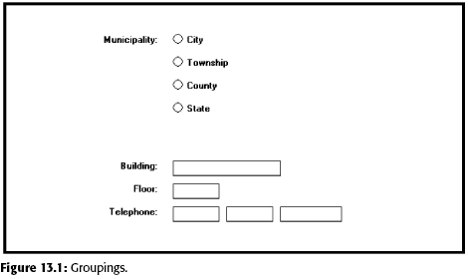
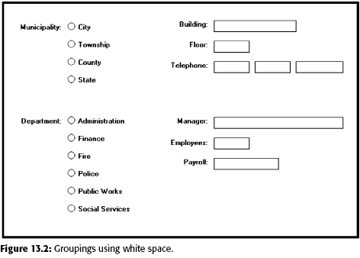
Organization Guideline (Creating Grouping)

Slide 13
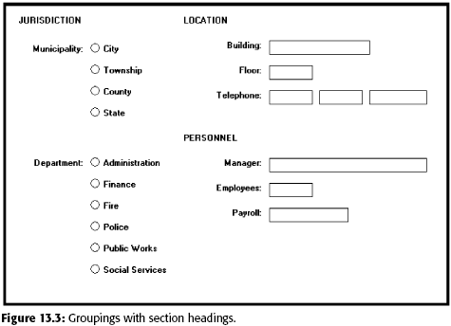
Organization Guideline (Creating Grouping)

Slide 14
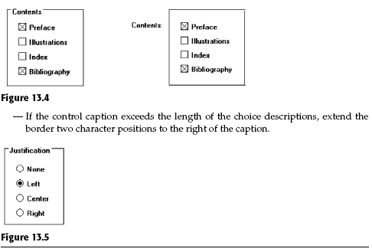
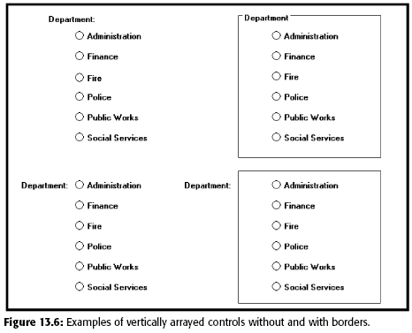
Organization Guideline (Creating Grouping)

Slide 15
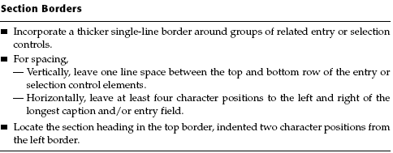
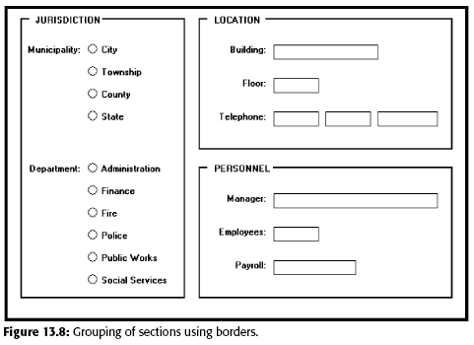
Organization Guideline (Creating Grouping)

Slide 16
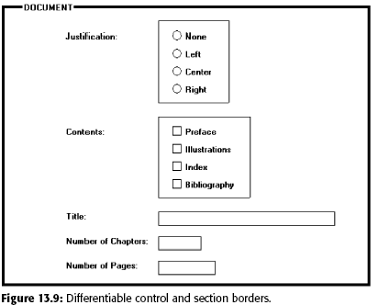
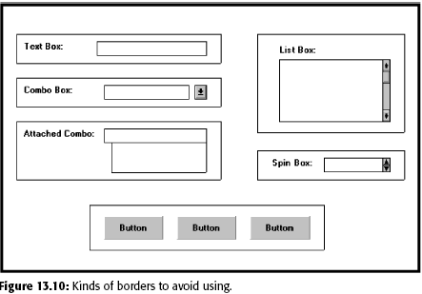
Organization Guideline (Creating Grouping)

Slide 17
Web Page Guidelines
General
Element
To keep pages simple, restrict the number of distinct functional element on a page, element include such tittle, navigation bar, textual link to major site area, textual content, graphics and page footer
Layout Grid
Establish a standard layout grid
Size
Efficient
Logical and consistent
Self explanatory
Scannable
Proper Balance
Consistency in every page
Better alignment and visual connection between element
Page Length: Minimize page length, restricting it to two or three screens of information
Anticipate Page Breaks
Horizontal scrolling: Layout page so horizontal scrolling is never necessary

Slide 18
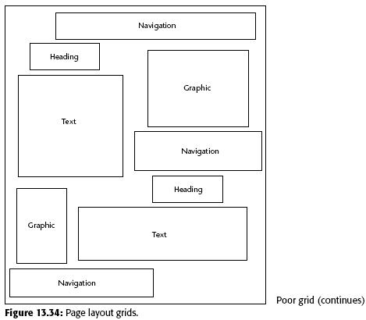
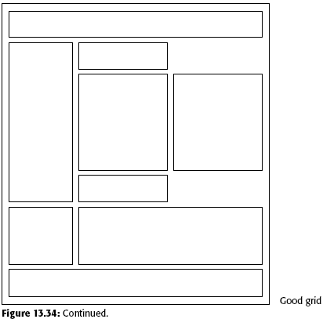
Grid Example (Poor VS Good)

Slide 19

What do you think about this GRID??

Slide 20
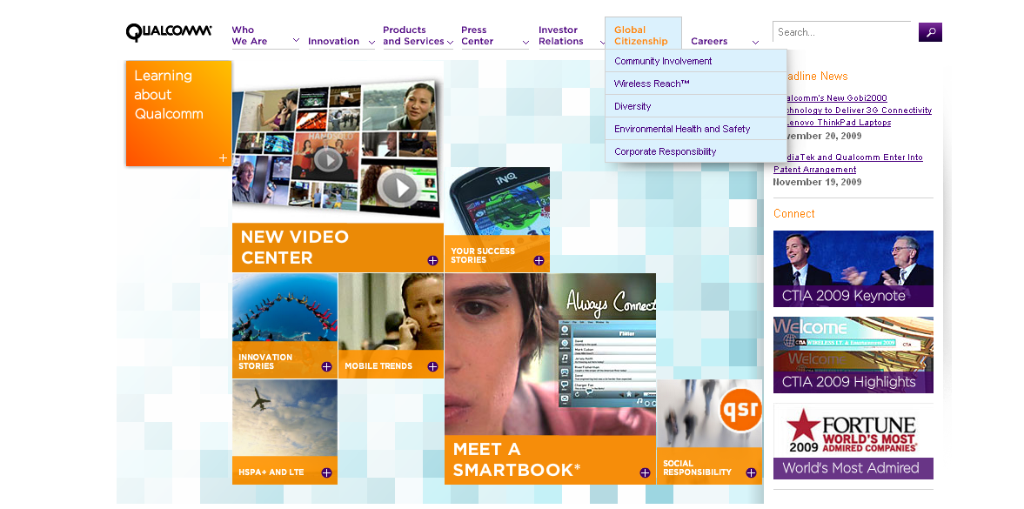
What do you think about this GRID??

Slide 21
Web Page Guidelines (cont..)
Organization
Present information in different level of detail
Formatting
White Space
Platform
Important element at the top
Textual Line Length
Better alignment and visual connection between element
Anticipate the typical screen and resolution and specify an image save area of the screen that will always be visible to most viewer
Positioning
Reduced Complexity
Text
Multiple Audience

Slide 22
Web Page Guidelines (cont..)
Navigation element
Homepage
Limit to one screen
Provide a global navigation bar at the top of each page
Provide a local category or topical links navigation bar on the left side of a page
Optionally, provide a secondary navigation column on the right side of the page
Place minor illustrative, parenthetical, or footnote links at the end
For long pages provide “list of contents” link
Create a common and consistent theme
Never create pages without navigational options
Clearly identify the web site content and purpose
Element to include: Name or logo and tagline, web site name, brief desc of web site, Summary of the key informational content, Navigational links to most of the site of major section
Site map
Summary of the lattest news or promotion
Search facility

Slide 23
Layout Examples

Slide 24
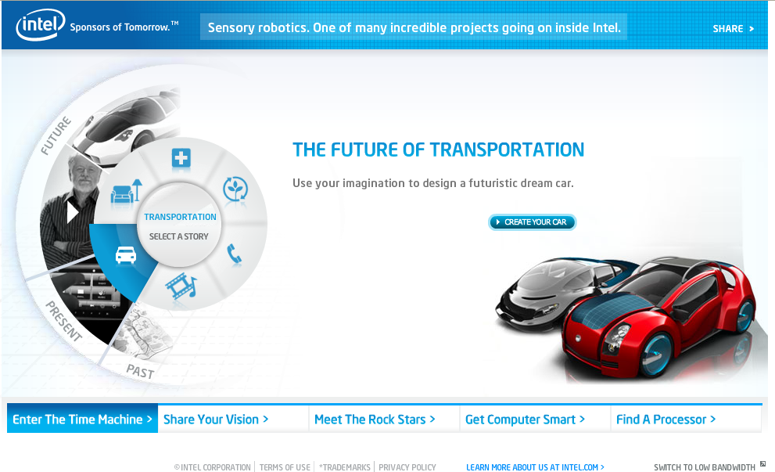

Slide 25
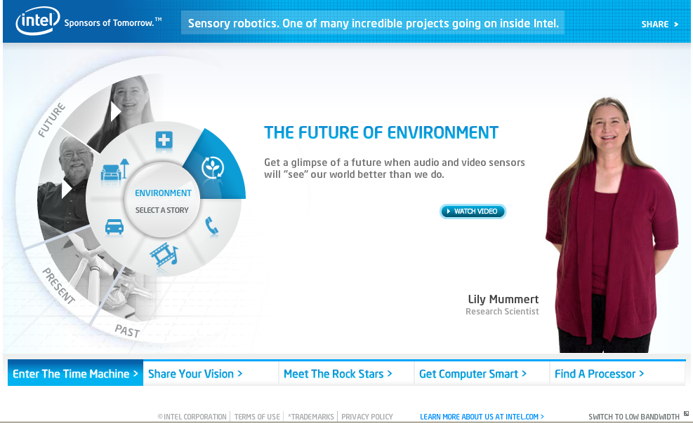

Slide 26
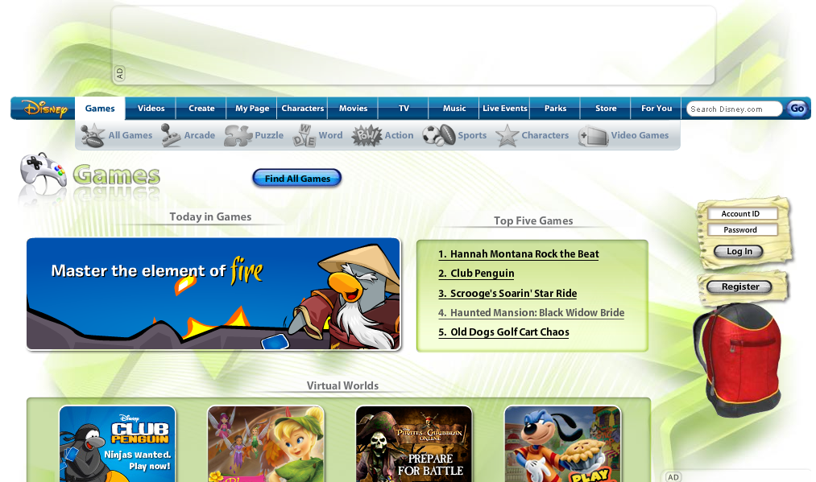
Scroll down!!

Slide 27
Interaksi Manusia dan Komputer (IMK)
THE USER INTERFACE (UI) DESIGN PROCESS
Step 14 Testing

Slide 28
Tujuan
Setelah mengikuti materi ini mahasiswa dapat:
Mahasiswa/i dapat memahami konsep pengujian dalam desain UI dan cara mengukur UI

Slide 29
Usability Testing

Slide 30
Evaluation Of Usability
There are different approaches to evaluating usability, three main categories (Chandler&Hyatt,2002) :
Inspection methods : do not involves customer. Heuristic evaluations and walk-throughs
Lab testing methods : involves the testing of representatives users.
Surveys and customer reporting methods : provides subjective data and is based on expressed feelings, attitudes, and perceptions of the interaction’s usability and overall desirable qualities.

Slide 31
Types of Usability Testing

Slide 32
Heuristic Evaluation
Based on the expertise of a set reviewers.
Generally apply across situations and are used to predict potential problems with the interaction.
Has the advantage of being easy to use and does not require expensive lab settings.
Kalbach (2007) identifies 3 steps for heuristic evaluation :
Prepare : Agree on who will do the review.
Execute : Go through the interaction prototype, focusing on one principle at a time.
Consolidate : Discuss your findings with other reviewers.

Slide 33
Heuristic Evaluation (Cont)
Nielsen (1994) proposed 10 general “Heuristics” :
Visibility of system status
Match between system and the real world
User control and freedom
Consistency and standards
Error prevention
Recognition rather than recall
Flexibility and efficiency of use
Aesthetic and minimalist design
Help users recognize, diagnose, and recover from errors
Help and documentation

Slide 34
Heuristic Evaluation (Cont)
Kalbach(2007) proposed the following heuristic specific to web based interactions :
Balance
Ease of learning
Efficiency
Consistency
Clear labels
Orientation
Exploration
Differentiation
Information use
Modes of searching

Slide 35
Heuristic Evaluation (Cont)
Heuristic evaluation can be also accelerated with the use of checklists.
A sample checklist can be found at http://www.stcsig.org/usability/topics/articles/he-checklist.html.
Given the high cost of conducting interaction evaluations, new trend is towards automated evaluation. For example, free tools include :
Wave : http://wave.webaim.org
InFocus : www. Ssbtechnologies.com/products/infocus

Slide 36
Walk-throughs
Walk-throughs simulate a customer’s experience with the interaction.
The results of the simulation are compared with the goals, expectations, and knowledge that the first-time customer is expected to have with an online store

Slide 37
Web Accessiblity
It is about building web sites, applications, and pages that present few barriers to use are possible for anyone, regardless of ability and the device used to access the information.
Web accessibility should be :
Accommodate persons with disabilities (visual disabilities, hearing disabilities, Physical disabilities and Cognitive and neurological disabilities)
Provide access to those using slower connections that normally have the images tuned off as well as increase interoperability with mobile devices.

Slide 38
Web Content Accessiblity Guidelines (WCAG)
WCAG 1.0
Guidelines 10 : Use interim solutions.
Guidelines 11 : Use W3C technologies and guidelines.
Guidelines 12 : provide context and orientation information.
Guidelines 13 : provide clear navigation mechanism.
Guidelines 14 : ensure documents are clear and simple.
WCAG 2.0
Content must be perceivable.
User interface components in the content must be operable.
Content and controls must be understandable.
Content mst be robust enough to work with current and future technologies.
See www.w3.org/WAI/GL/2005/06/30-mapping .html

Slide 39
Usability Testing
Answer four key questions about an interaction.
Learnability - how easy does the learning take place?
Throughput - how easy is it to use ?
Flexibility - how easy is it to change in environment and tasks?
Attitude – doe it provide the user with a positive attitude?

Slide 40
Usability independent and dependent variables (Eason, 1988)
Independent Variables | Dependent variables
User Characteristic : Knowledge Discretion Motivation | User reaction-cost benefit analysis (positive outcome) Good task system match Continued user learning
System function: Task match Ease of use Ease of learn | User reaction-cost benefit analysis (negative outcome) Restricted use Non-use, partial use Distance use
Task characteristic : Frequency Opennes

Slide 41
Usability Measures (Shackle, 1990)
Measure | Comments
Effectiveness | At better than some required level of performance(in terms of speed and errors) By some required percentage of the specified target range of users Within some required proportion of the range of usage environments
Learnability | Specified time from installation and start of training Based upon some specified amount of training Some specified relearning time for intermittent users
Flexibility | Allowing adaptation to some percentage variation in task beyond those first specified(difficult to determine in practice and acan be replaced by usefulness-achievement of user’s goals)
Attitude | Within acceptable levels of human cost in terms of tiredness, discomfort, frustration, and personal effort

Slide 42
Steps of Testing

Slide 43
Conducting the usability test
First conducting is a pilot test.
A pilot test allows to “debug’ the test and find out if there any initial problems with the interaction under test.
Usability tests might be conducted in usability testing laboratories. If labs are not available another viable solution is go to the customer’s location.
Users can be interviewed as they are performing the task. Make sure the questions are specific so the tester can get the answers.

Slide 44
Analyzing and Presenting Usability Test Results
Data collected from usability test (Dumas&Redish,1999)
A list of problems from the test
Quantitative data on time, errors, and other performance measures, including subjective ratings on questionnaires
Tester’s comments from logs, notes, and questionnaires
The testing team’s written notes
Background data on the participants
Videotapes of the test, perhaps from several different viewpoints in the room
That the analysis should follow some guidelines to make statistical analysis as relevant as possible :
Use inferential statistics only if you understand how to apply and interpret them
After you employ a statistical test, carefully explain what the test means
Describe your interpretation of key data values when you don’t compute statistical tests.

Slide 45
Analyzing and Presenting Usability Test Results (Cont)
Both your quantitative data analysis as well as the qualitative data from feedback and notes will help you organize the information into two areas :
Scope – How widespread is the problem?
Severity – How critical is the problem ?
A final report should be prepared to summarize the results of the test. The following sections for a usability test :
Procedures
Evaluator profiles
Observations
Evaluator quotes
Conclusions
recommendations
A sample usability report and data analysis can be downloaded from the link below :
http://www.utexas.edu/learn/usability/report.html

